Slide 1

Project Title: Knowbot Quiz Generation
Project Members:
Supervisor Name:
Gaurav Shukla | 2000910100067
Divyansh Shandilya | 2000910100062
Abhinav Garg | 2000910100005
Divyam Dua | 2000910100061
Mrs. Surekha M

Slide 2
CONTENTS OF THE PPT
INTRODUCTION
OBJECTIVES
LITERATURE SURVEY
HARDWARE AND SOFTWARE REQUIREMENTS
TIMELINE AND GANTT CHART
CONCLUSION
REFERENCES

Slide 3

Introduction
Questions, particularly Multiple Choice Questions (MCQs), are fundamental tools for assessing a learner’s knowledge and understanding, playing a pivotal role in the educational process.
Advantages of MCQs: MCQs offer several notable advantages, including expedited evaluation, reduced testing time, consistent scoring, and the ability to facilitate electronic assessments.
Challenges and Solutions: Crafting MCQs manually can be time-consuming and expensive. To address this, the research community has developed methods for the automated generation of MCQs.
Future of MCQ Generation: With advancing technology, the automated generation of MCQs is set to become an essential component of educational assessment, benefitting both educators and learners.

Slide 4

OBJECTIVES
.
In the wake of Covid-19, the swift shift to online education underscored the need for efficient test creation tools to allow educators to focus more on teaching. Our objectives are:
Efficiency: Reduce the average time spent on creating a class test.
Integrity: Generate unique questions to minimize the use of unfair means.
Automation: Use natural language processing and machine learning for automatic question generation.
User Base: Cater to the large user base depending on online tools for test assessment and generation.

Slide 5
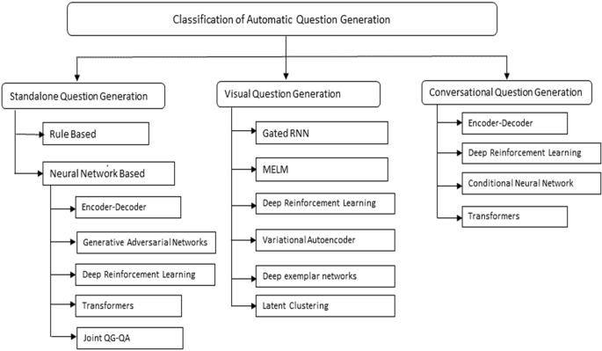
LITERATURE SURVEY
Introduction and Problem Statement
The project presents a system for generating multiple-choice questions (MCQs) from text using natural language processing (NLP) techniques.
Automatic question generation (AQG) is the task of generating questions from various sources of information, such as text, images, videos, or conversations. AQG has many applications in education, assessment, and dialogue systems.
AQG from text is the most common and widely studied scenario. It involves generating questions that are relevant, diverse, and grammatically correct from a given text input.
The system aims to reduce human effort and improve the quality of MCQs by using NLP methods such as named entity recognition (NER), word embeddings, and homomorphic encryption.

Slide 6
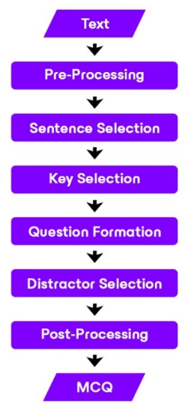
Methodology and Features
The system takes a PDF file or a text input as the source of information and performs text pre-processing to remove non-alphanumeric characters.
The system uses spaCy’s NER model to identify and rank named entities in the text, which are used as potential answers or keys for the MCQs1.
The system uses a Word2Vec model to generate incorrect options or distractors for the MCQs by finding similar but less relevant entities for each key.
The system uses homomorphic encryption to encrypt the MCQs and prevent cheating or unfair means by the users.
The system provides a smart quiz generation portal that can be used for self-assessment, question paper generation, and evaluation2.

Slide 7

HARDWARE & SOFTWARE REQUITEMENTS
Hardware:
High-performance GPU (Graphics Processing Unit): Our project requires access to a high-performance GPU to accelerate the training and evaluation of deep learning models
Software:
Python Programming Language: Python serves as the primary programming language for our project
Jupyter Notebook: Jupyter Notebook provides an interactive and user-friendly development environment for our project.

Slide 8
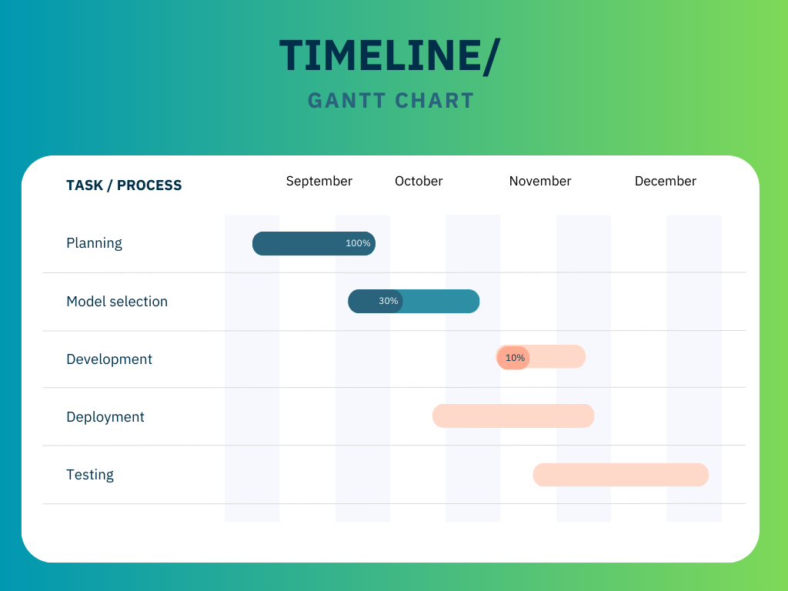
TIMELINE CHART/ GANTT CHART

Slide 9
CONCLUSION
This paper critically examines automatic MCQ generation from text. It outlines a six-phase workflow: preprocessing, sentence selection, key identification, question formulation, distractor creation, and postprocessing. Various strategies for each phase are discussed, alongside a comparative analysis of different methods. Evaluation techniques for generated MCQs are also highlighted.

Slide 10
REFERENCES
Dhawaleshwar Rao, CH Sujan Kumar Saha, “Automatic Multiple Choice Question Generation,” in IEEE Journal, IEEE TRANSACTIONS ON LEARNING TECHNOLOGIES, VOL. 13, NO. 1, JANUARY-MARCH 2020.
Riken Shah, Disha Shah, “Automatic Question Generation for Intelligent Tutoring System,” in IEEE Journal, 2017 2nd International Conference on Communication Systems, Computing, and IT Applications (CSCITA).
Mushale Ashish, Shafali Gupta, “An automatic generator of multiple-choice question with random answer key,” JETIR June 2020, Volume 7, Issue 6.
M. Agarwal and P. Mannem, “Automatic gap-fill question generation from textbooks,” in Proceedings of the 6th Workshop on Innovative Use of NLP for Building Educational Applications, ser. IUNLPBEA ’11. Stroudsburg, PA, USA: Association for Computational Linguistics, 2011.
Afzal, N. and Mitkov, R. (2014) ‘Automatic generation of multiple-choice questions using dependency-based semantic relations’, Soft Computing - A Fusion of Foundations, Methodologies and Applications.

Slide 11
THANK YOU

